Slide 1
Topic 7: Control STEAM PBL —— DIY smart control system: part 1 Automatic sensor viewer
IBDP Computer SCIENCE
Di WU

Slide 2
Lesson orientation
Stage 1: self exploration of Arduino: hardware + software
10 minutes
Introduction
Cooperative Learning:
Sensor + Arduino + Python
Stage 2: Automatic sensor viewer
25 minutes
Topic 7: control
STEAM PBL
DIY smart control system
35 minutes
Stage 3: Arduino + Android
Wireless Remote control
Reciprocal Learning and practice
3 developing groups
Stage 4: DIY innovation
Presentation of your prototype !
10 minutes

Slide 3
Computer system
Internal memory
Input device
Processor
Output device
Backing
storage device

Slide 4
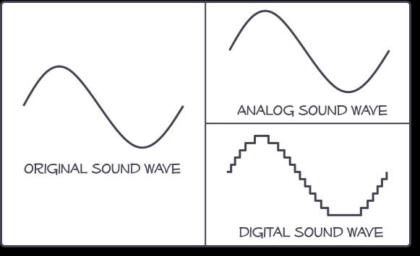


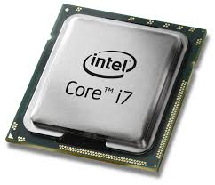
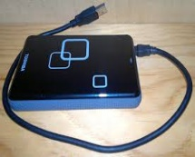
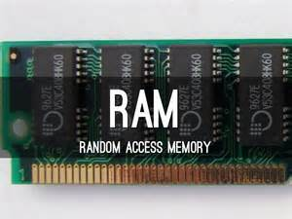
Analog to Digital Converter
Physical world
Sensor
Analogue signal: smoothly changing
Input
Processing
Storage
Digital signal: step-valued
Computer Output
Digital to Analog Converter
Physical world
Actuator
Analogue signal: smoothly changing
Output

Slide 5
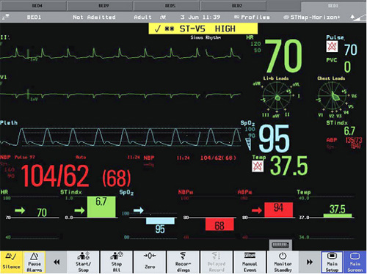
Smart control system: STEAM PBL
Monitoring hospital patients
How equipment monitors vital signs
How the system knows when to notify doctor
Temperature sensor
Temperature
Infrared sensor
Pulse rate
visible light sensor
Blood oxygenation
Pressure sensor
Blood pressure
Stretch sensor
Respiratory rate
chest electrodes
Electro-cardiogram

Slide 6
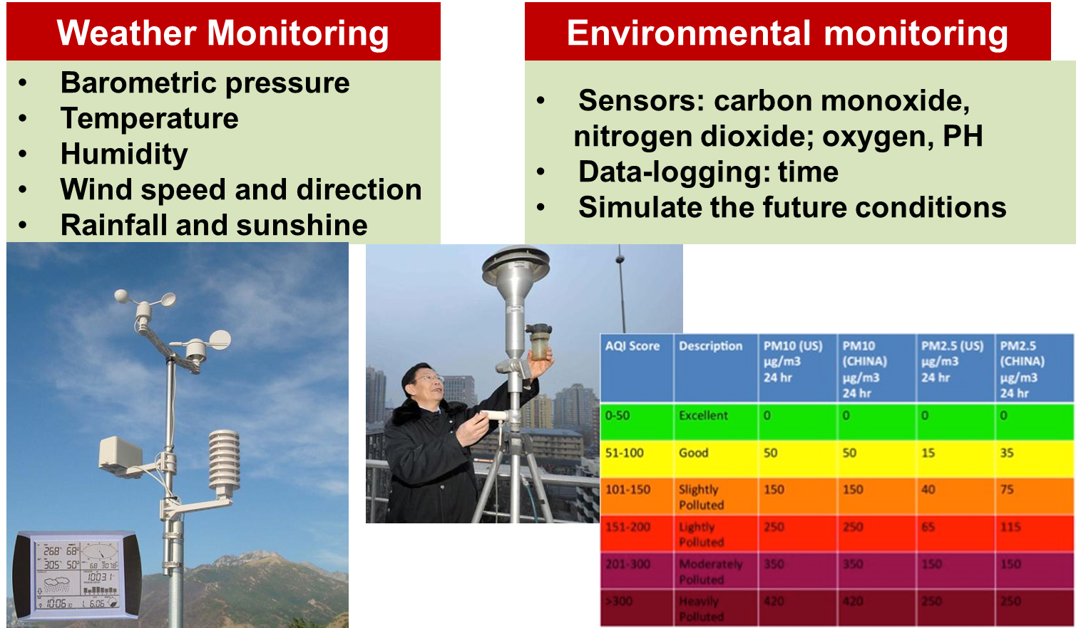
Smart control system: STEAM PBL

Slide 7
Smart control system: STEAM PBL
Aim: DIY your own smart control system
Prototype: Software and hardware
Assessment: Demo for investing!
Science:
Control science feedback
Analog digital conversion
Physics: circuits and sensors
Technology:
Communication technology: Serial
programming
Engineering: Building prototype
Electronics
Art:
Creativity and life hacker
Math:
Logic calculation
Mapping and

Slide 8

Automatic sensor viewer: introduction
Stage 1: task

Slide 9
Lesson orientation
Michael
Enzo
David
10 minutes
Topic 1: Sensors
Introduction
Cooperative Learning:
Sensor + Arduino + Python
Stage 2: Automatic sensor viewer
20 minutes
Arthur
Charles
Margaret
Topic 2: Arduino
35 minutes
Reciprocal Learning and practice
3 developing groups
Doris
Alex
Matt
Topic 3: Python
Presentation of your prototype !
15 minutes
TA: Tom

Slide 10
Topic 1: sensors
1. Ultra-sound sensor: HCSR04
2. Temperature sensor: LM35
3. Infrared sensor
4. Light dependent resistor (LDR, need 10K resistor)
5. Potentiometer/ voltage divider
https://create.arduino.cc/projecthub/microBob/ultra-sonic-ping-sensor-a9c49e
Sensors
+
Arduino
+
Python
http://playground.arduino.cc/Main/LM35HigherResolution
Tasks:
1. Choose at least 3 sensors to study
2. Understand how the sensors work
3. Connect the sensors to Arduino, build circuits
4. Try to use Arduino serial monitor to test the success of installation of the sensors

Slide 11
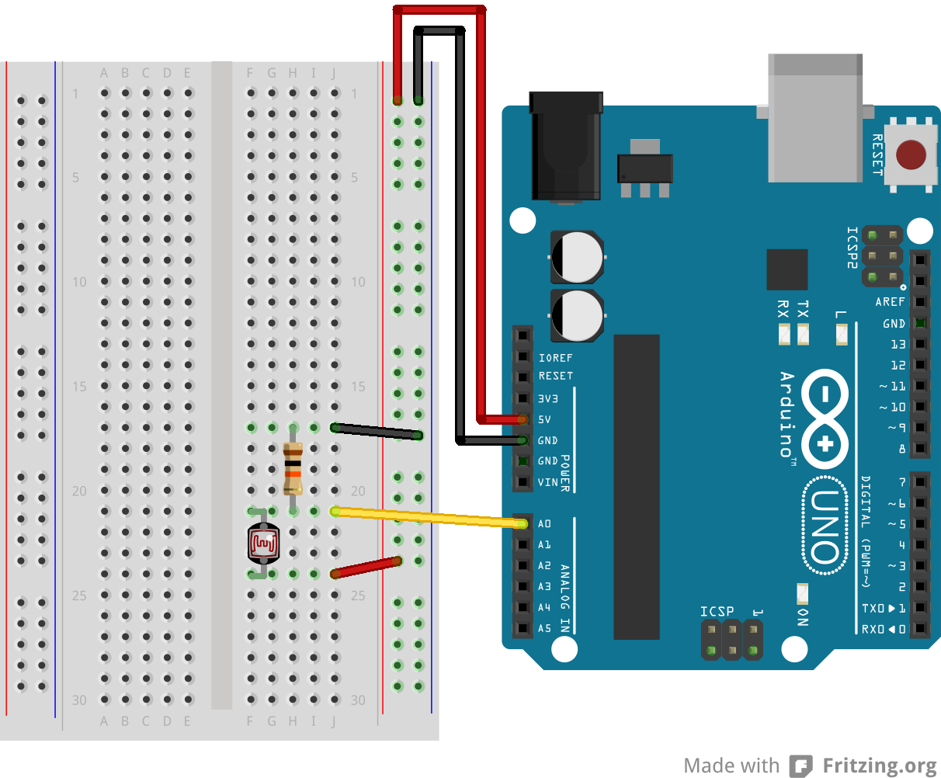
Topic 2: Arduino
Sensors
+
Arduino
+
Python
Tasks:
1. Understand all pins analog/digital & input & output of arduino
2. Study how to read Analog input: https://www.arduino.cc/en/Tutorial/AnalogInput
3. Study how to use serial port communication between Arduino and PC (python) , you can use one source first
Check in the Arduino serial monitor
https://gist.github.com/electronut/5641938
Notes:
https://stackoverflow.com/questions/13373415/pyserial-and-readline-return-binary-string-convert-to-regular-alphanumeric-s

Slide 12
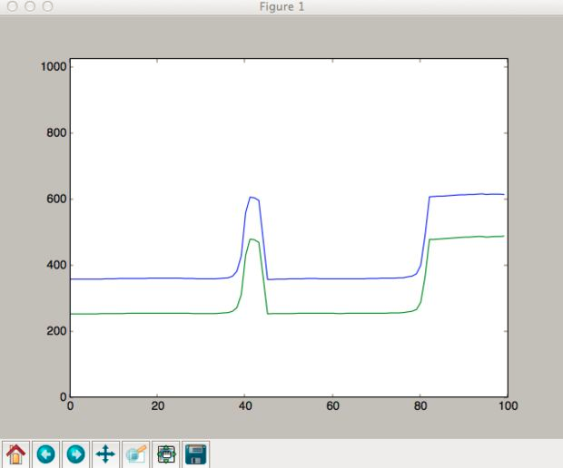
Topic 3: Python
Sensor
+
Arduino
+
Python
Tasks:
1. Python for reading from serial port
2. Study how to Display analog data from Arduino using Python (matplotlib): https://gist.github.com/electronut/d5e5f68c610821e311b0
3. Do simulation with generated data
MODIFY to one source first

Slide 13
Lesson orientation
You have 25 minutes to investigate each topic with your team
Michael
Enzo
David
10 minutes
Topic 1: Sensors
Introduction
Cooperative Learning:
Sensor + Arduino + Python
Stage 2: Automatic sensor viewer
20 minutes
Arthur
Charles
Margaret
Topic 2: Arduino
35 minutes
Reciprocal Learning and practice
3 developing groups
Doris
Alex
Matt
Topic 3: Python
Presentation of your prototype !
15 minutes
TA: Tom

Slide 14
Lesson orientation
You have 35 minutes to Create your own sensor viewer based on your new group
10 minutes
Introduction
TA: Tom
Jigsaw groups
Cooperative Learning:
Sensor + Arduino + Python
Michael
Margaret
Doris
Michael
Enzo
David
Stage 2: Automatic sensor viewer
20 minutes
Group A
35 minutes
Reciprocal Learning and practice
3 developing groups
Arthur
David
Alex
Arthur
Charles
Margaret
Group B
Presentation of your prototype !
Enzo
Charles
Matt
Doris
Alex
Matt
Group C

Slide 15
Reciprocal Learning
Michael
Margaret
Doris
Group A
Assessment:
Prototype (50%): demo it works
Presentation (30%) : intuitive explanation
Interaction(20%): audience trial
Creativity: embedded in 1-3
Reciprocal Learning and practice
3 developing groups
Arthur
David
Alex
Group B
Enzo
Charles
Matt
Group C
TA: Tom

Slide 16
Lesson orientation
Each group has 3 minutes to present your invention!
10 minutes
Introduction
Jigsaw groups
Cooperative Learning:
Sensor + Arduino + Python
Michael
Margaret
Doris
Stage 2: Automatic sensor viewer
20 minutes
Group A
35 minutes
Reciprocal Learning and practice
3 developing groups
Arthur
David
Alex
Group B
TA: Tom
Presentation of your prototype !
Enzo
Charles
Matt
Group C

Slide 17
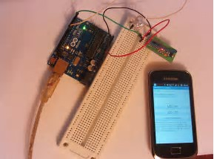
Next: Arduino + Android(App Inventor)
Stage 1: self exploration of Arduino: hardware + software
Stage 2: Automatic sensor viewer
Topic 7: control
STEAM PBL
DIY smart control system
Stage 3: Arduino + Android
Wireless Remote control
Smart phone + smart control
Stage 4: DIY innovation
https://create.arduino.cc/projecthub

